Slide 1



Bilgisayar Mühendisliği Bölümü
GTU CENG CSE 496
PRELIMINARY-PRESENTATION
Predicting Chemical Exergy in the Yuvacık Dam Basin
under Climate Scenarios using Machine Learning
Muhammed Yasir Güneş
Project Consultants:
Prof. Dr. Yusuf Sinan AKGÜL
Prof. Dr. Mahir İNCE
Notes:
<number>

Slide 2
Contents
Project Overview
What is Exergy
Project Diagram
Project Requirements
Success Criteria
Timeline of the Project
References
GTU - Computer Engineering Department
CSE 496 Graduation Project
Notes:
<number>

Slide 3
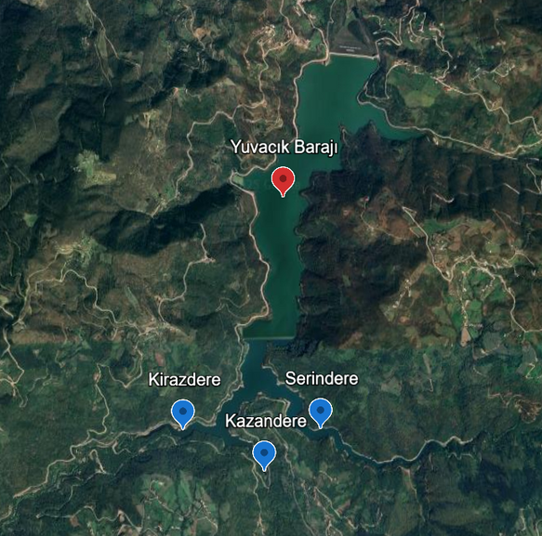
Project Overview
Purpose: Predict how climate change affects water quality in Yuvacık Dam’s rivers (Kirazdere, Kazandere and Serindere) using chemical exergy.
Problem: Climate change may degrade water in rivers like Kazandere, impacting Kocaeli’s water supply.
Goal: Use machine learning to estimate exergy under RCP 4.5 (moderate) and RCP 8.5 (pessimistic) scenarios up to 2050.
GTÜ - Bilgisayar Mühendisliği Bölümü
BİL 495/496 Bitirme Projesi
GTU - Computer Engineering Department
CSE 496 Graduation Project

Slide 4

What is Exergy?
Energy = Total work
Exergy = Total usable work
Exergy measures the usable energy.
Exergy is maximum amount of useful work that can be extracted from a system before it reaches equilibrium with its environment.
Exergy = Chemical Exergy ✅ + Physical Exergy
A water with high exergy ➡️ High water quality and usability. ➡️ Different from its environment (polluted water).
Calculated by Ion concentrations (e.g., Na⁺, Cl⁻, Fe³⁺), pH level, Dissolved substances
GTÜ - Bilgisayar Mühendisliği Bölümü
BİL 495/496 Bitirme Projesi
GTU - Computer Engineering Department
CSE 496 Graduation Project

Slide 5
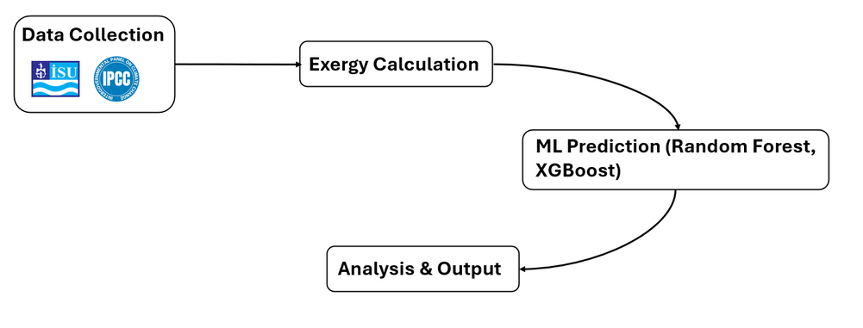
Project Diagram
In 4 steps:
Data Collection: ISU Data (streamflow, ion concentration), RCP Scenario (climate variables e.g. total rainfall, temperature, humidity etc.)
Exergy Calculation: Write a python script to calculate exergy for each timestep.
ML Prediction: Predict the exergy for upcoming years.
Analysis & Output: Analyze the exergy results for the scenarios.
GTÜ - Bilgisayar Mühendisliği Bölümü
BİL 495/496 Bitirme Projesi
GTU - Computer Engineering Department
CSE 496 Graduation Project

Slide 6
Project Requirements
Datasets for each river from ISU and IPCC should be obtained.
Python script for exergy calculation for each timestamp using the dataset should be developed.
Random Forest or XGBoost models for each river should be trained.
RCP 4.5/8.5 climate data should be integrated.
The models should be optimized for accuracy (RMSE < 0.5 kJ/mol).
This tech stack should be used: "Python, Pandas, Scikit-learn, XGBoost, Tensorflow, Keras"
GTÜ - Bilgisayar Mühendisliği Bölümü
BİL 495/496 Bitirme Projesi
GTU - Computer Engineering Department
CSE 496 Graduation Project

Slide 7
Success Criteria
Trained models should predict exergy with:
R² ≥ 0.8.
RMSE < 25 kJ/mol
Up to year 2050.
GTÜ - Bilgisayar Mühendisliği Bölümü
BİL 495/496 Bitirme Projesi
GTU - Computer Engineering Department
CSE 496 Graduation Project

Slide 8
Project Timeline
2025
Mar | Apr | May | Jun
PHASE 1
PHASE 2
PHASE 3
PHASE 4
March 14 – March 31
April 1 – May 20
May 21 – Jun 10
Jun 11 – Jun 24
Phase 1: Research & Planning.
Phase 2: Design & Development
Tasks: Collect ISU data, set up Python.
Deliverables: Data access, script draft
Tasks: Clean data, calculate exergy, train ML models.
Deliverables: Processed dataset, trained models.
Phase 3: Testing & Refinement
Phase 4: Finalization & Documentation
Tasks: Test models, predict exergy, validate.
Deliverables: Optimized models with achieved success criteria
Tasks: Analyze predictions, finalize report, prepare demo and presentation.
Deliverables: Final report, presentation.
GTÜ - Bilgisayar Mühendisliği Bölümü
BİL 495/496 Bitirme Projesi
GTU - Computer Engineering Department
CSE 496 Graduation Project

Slide 9
References
Bilgen, S., & Bulut, H. (2014). Investigation of the chemical exergy and water quality of the Galyan River, Trabzon, Turkey. Energy Sources, Part A: Recovery, Utilization, and Environmental Effects, 36(15), 1675-1683.
Katipoğlu, O. M., Acar, R., & Şenocak, A. (2022). Trend analysis of hydrological droughts in Yeşilırmak Basin by Mann-Kendall and Şen Innovative Trend Analysis. Water Resources Management, 36(3), 1121-1136.
IPCC. (2021). Climate Change 2021: The Physical Science Basis. Contribution of Working Group I to the Sixth Assessment Report of the Intergovernmental Panel on Climate Change. Cambridge University Press.
Kaya, M. Y., & Kahraman, C. (2022). Deep learning approach for prediction of exergy and emission parameters of commercial high by-pass turbofan engines. Frontiers in Energy Research, 10, 1036824.
Li, X., Liu, X., & Li, J. (2024). Water quality prediction based on sparse dataset using enhanced machine learning. Scientific Reports, 14, 56775.
GTÜ - Bilgisayar Mühendisliği Bölümü
BİL 495/496 Bitirme Projesi
GTU - Computer Engineering Department
CSE 496 Graduation Project

